Slide 1
Analyzing MTA Subway Delays (2020-2024)
Debraj Das

Slide 2
Motivation
New Yorker who strongly dislikes delays with the MTA
Uncover common causes in MTA subway delays

Slide 3
Data Source
NYS open data
7 columns: Month, Division, Line, Day Type, Reporting Category, Subcategory, Delays
40,503 rows
Data was very clean, no missing or null values in columns I used
Only had to change numeric values for weekday/weekend using map function

Slide 4
Research Questions
Which lines have the most delays and what are their top causes?
How do delays differ between weekdays and weekends by reporting category?

Slide 5
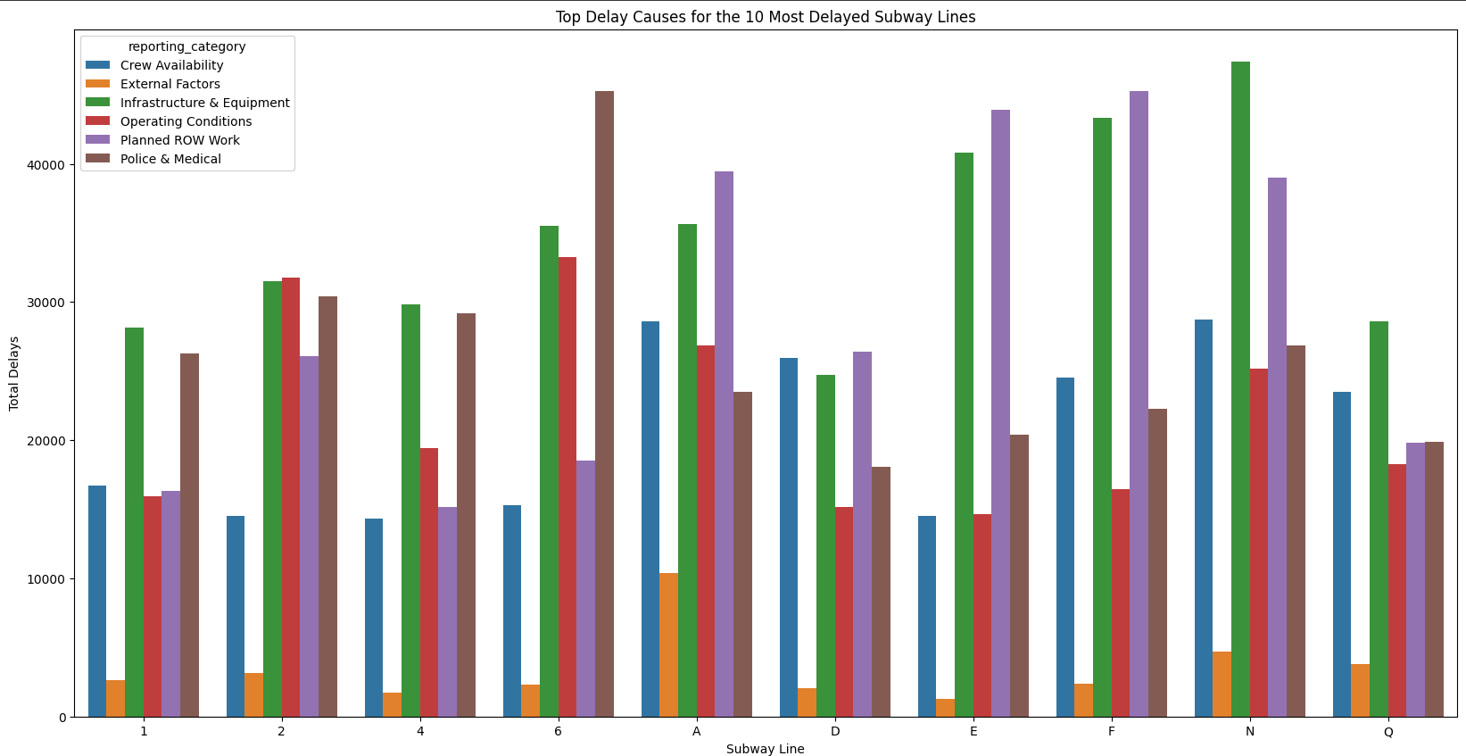
Visualizations
Just looking at this the green bars (infrastructure & equipment) look the highest among the top 10 delayed lines.

Slide 6
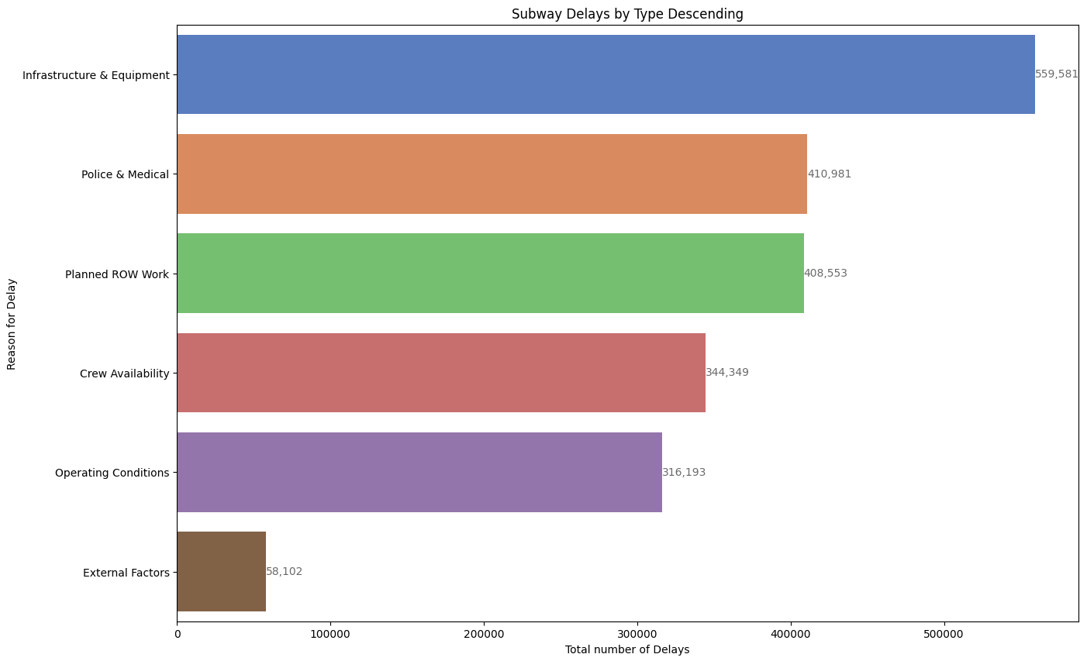
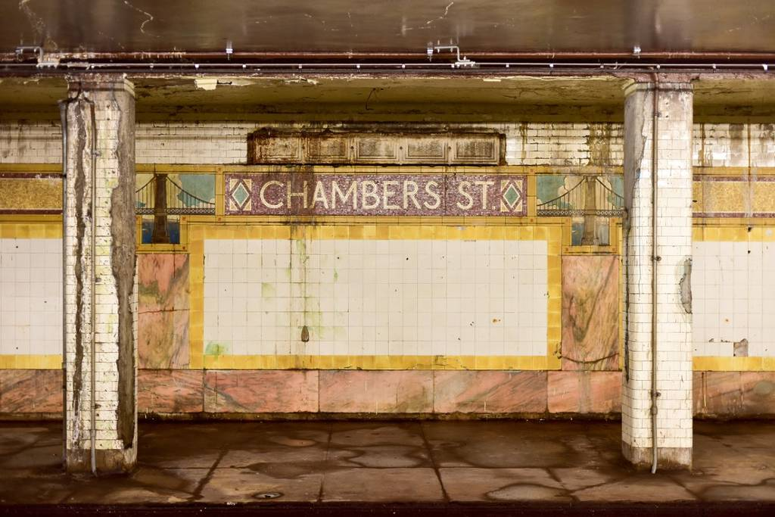
Visualizations cont.
Confirms the finding from previous visualization that Infrastructure & Equipment is the leading cause for delays.

Slide 7
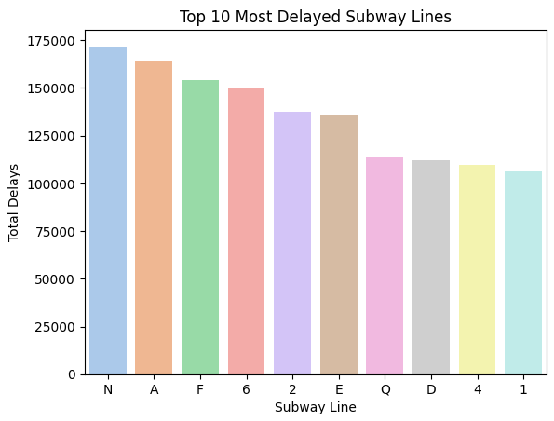
Visualizations cont.
Top 3 lines with most delays are the N, A, and F lines.

Slide 8
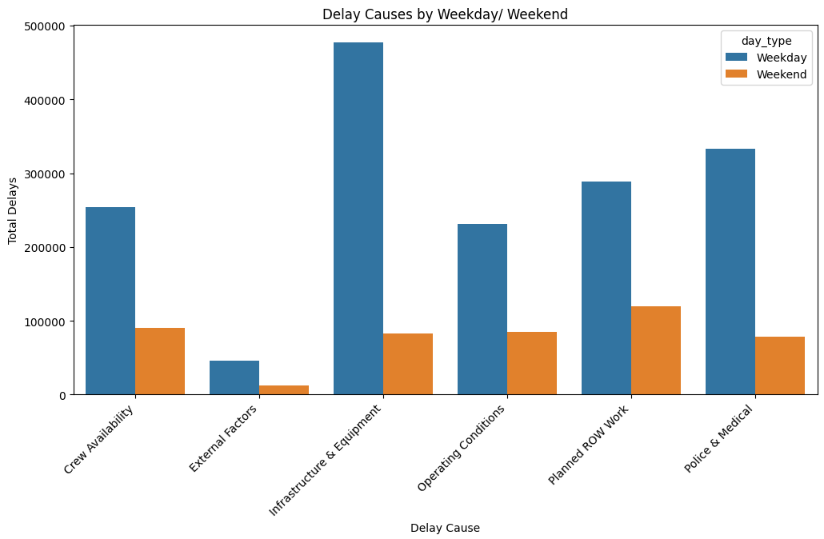
Visualizations cont.
Weekdays have more delays overall with the leading cause being infrastructure and equipment, but on Weekends the leading cause for delays is planned work.

Slide 9
Insights
Insight 1
Insight 2
Insight 3
Top 3 most delayed subway lines were the N, A, and F lines.
Most Delays are due to the Infrastructure & Equipment.
Weekday delays are higher overall. Weekend delays are mostly from Planned ROW Work.
If data included every day we could have seen which day had the most delays.

Slide 10
Resources
https://data.ny.gov/Transportation/MTA-Subway-Trains-Delayed-Beginning-2020/wx2t-qtaz/about_data
https://offloadmedia.feverup.com/secretnyc.co/wp-content/uploads/2024/05/10132742/chambers-1024x683.jpg

